Slide 1


Banking Data
Analytics
A systematic approach to identify, analyze, and resolve issues effectively

Slide 2

Index
Intro
Data Overview
Objectives-KPIs (2 data KPI)
Process
Analysis
Recommendations and Insights
Conclusion
Challenges and learning
Dashboard/SQL report

Slide 3
Introduction
Banking Data Analysis Project
This project focuses on analyzing banking loan and transaction data to understand financial performance and customer activity.
We worked with two major areas of banking data:
  Loan Portfolio Analysis
  Debit & Credit Transaction Analysis
The project covers the complete data analytics process, from data preparation and SQL analysis to dashboard creation and visualization.
We used Excel, SQL, Tableau, and Power BI to analyze the data and present meaningful insights.

Slide 4
Data Overview
Loan Dataset
loan and customer-related information
Includes fields such as:
  Loan / Account ID
  Client information
  Funded Amount
  Interest and Collection
  Loan Status
  Loan Grade
  State & Branch
  Disbursement Date
  Default & Delinquency indicators
  Product Group
  Loan Maturity
2. Debit & Credit Transaction Dataset
Contains banking transaction information
Includes fields such as:
  Account / Transaction information
  Transaction Type
  Transaction Amount
  Transaction Date
  Branch
  Credit & Debit transactions
Data Preparation & Connection
Data was prepared and analyzed using Excel and MySQL/SQL.
Tableau was used for data visualization and dashboard creation.
Power BI was connected to the MySQL database using ODBC.
Final analysis and dashboards were developed across Excel, SQL, Tableau, and Power BI.

Slide 5
Objectives
Measure the total value and volume of loans issued.
Understand collections, interest earned and fee-based revenue.
Compare credit inflows with debit outflows and calculate net transaction movement.
Study Transaction activity across accounts, dates, branches and states.
Present key findings through KPI cards, charts and filters for easier exploration.

Slide 6

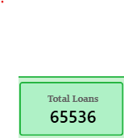


Loan Analytics KPIs
Total Loan Amount Funded -
This KPI shows the total amount of loans disbursed by the bank to customers
Sum of funded loan amounts; shows the overall value disbursed.
Total Loans-
This KPI shows the total number of loans issued by the bank to customers
Count of distinct loan/account records; show loan volume.
Total Collection -
This KPI shows the total amount collected by the bank from borrowers
Sum of total payments received; tracks repayment collections.
Total Interest-
This KPI shows the total interest earned by the bank from loans
Sum of interest received; indicates interest income in the dataset

Slide 7




Loan Analytics KPIs
Default Loan Rate -
This KPI shows the percentage of loans that have defaulted or failed to meet
repayment obligations. It helps us understand the bank’s loan risk and credit quality.
Delinquent Loan Rate -
This KPI shows the percentage of loans with overdue payments.
It helps the bank identify repayment delays and monitor loan performance.
Delinquent Client Count –
This KPI shows the total number of customers who have delayed
their loan payments. It helps the bank identify customers with repayment issues.
Default Loan Count -
This KPI shows the total number of loans that have defaulted. It helps the bank
identify loan repayment failures and assess credit risk

Slide 8
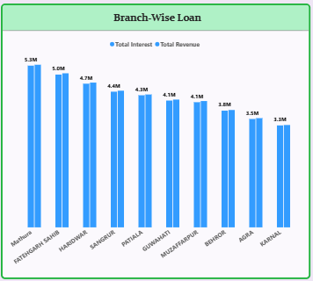
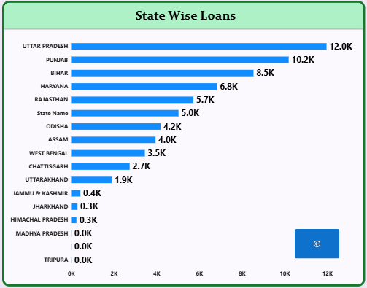
Loan Analytics KPIs
Branch-Wise Loan
This analysis shows the total loans distributed by each branch.
It helps compare loan performance across different branches.
It also helps identify branches with higher and lower loan distribution.
State-Wise Loan
This analysis shows the total number of loans in each state.
It helps compare loan distribution across different states.
It helps identify states with higher and lower loan activity

Slide 9
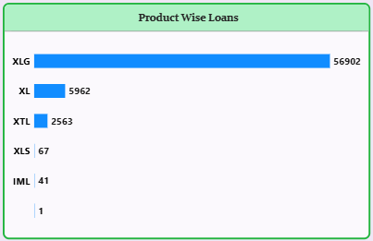
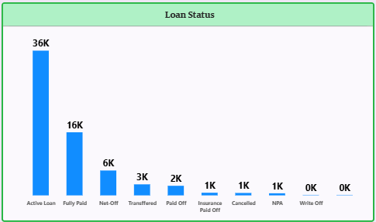
Loan Analytics KPIs
Product-Wise Loans
This analysis shows the distribution of loans across different loan products.
It helps identify which loan products have higher demand.
It helps compare loan activity across different products.
Loan Status
This analysis shows the distribution of loans based on their current status.
It helps understand how many loans are Current, Delinquent, or Default.
It helps monitor the overall repayment and loan performance.

Slide 10
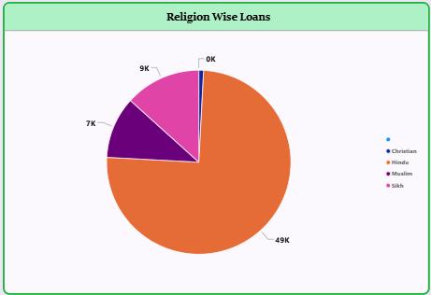
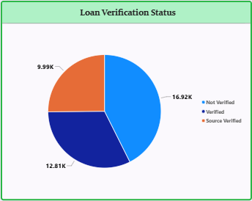
Loan Analytics KPIs
Religion-Wise Loans
This analysis shows the distribution of loans across different religious groups.
It helps understand loan distribution among the available categories in the dataset.
It provides a clear comparison of loan counts across these categories
Loan Verification Status
This analysis shows the distribution of loans based on their verification status.
It helps identify how many loans are Verified, Source Verified, or Not Verified.
It helps monitor the verification level of loan applications.

Slide 11
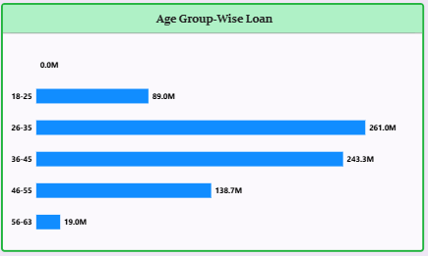
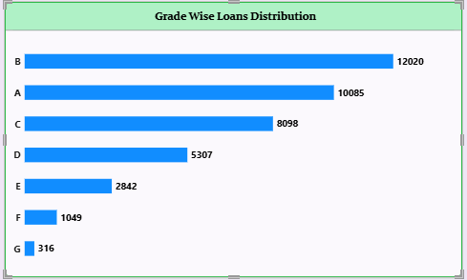
Loan Analytics KPIs
Age Group-Wise Loan
This chart shows the distribution of loans across different age groups.
It helps identify which age group has taken the highest number of loans.
This analysis helps banks understand customer borrowing patterns and make better lending decisions.
Grade –Wise Loan Distribution
This chart shows the distribution of loans across different loan grades.
It helps identify which grade has the highest number of loans.
This analysis helps banks understand borrower risk levels and assess loan distribution.

Slide 12
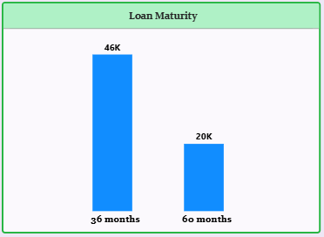
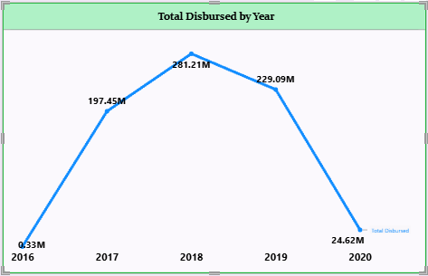
Loan Analytics KPIs
Loan Maturity
This chart shows the distribution of loans based on their repayment terms.
It compares loans with different maturity periods, such as 36 months and 60 months.
This analysis helps banks understand customer repayment preferences and loan duration patterns
Total Disbursed by Year
This chart shows the total loan amount disbursed in each year.
It helps identify yearly changes in loan disbursement.
This analysis helps banks understand lending trends and monitor loan growth over time.

Slide 13
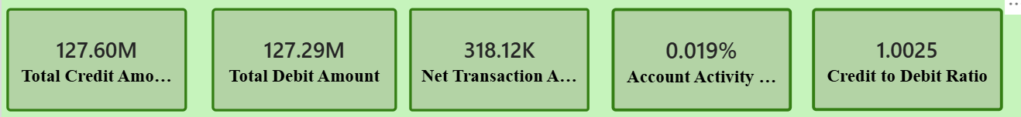
Bank Debit and Credit KPI
Total Credit Amount: 127.60M
Total money received into accounts
Shows overall inflow across all branches.
2. Total Debit Amount: 127.29M
Total money withdrawn or spent
Almost equal to credits, so outflow is well matched with inflow
3. Net Transaction Amount: 318.12K
Net = Credit − Debit
Positive balance, so inflow is slightly higher than outflow
4. Account Activity: 0.019%
Measures the share of activity relative to the total base
Very low value, which may suggest low variation or low engagement
5. Credit to Debit Ratio: 1.0025
Credit ÷ Debit
A value above 1 means inflow is greater than outflow

Slide 14
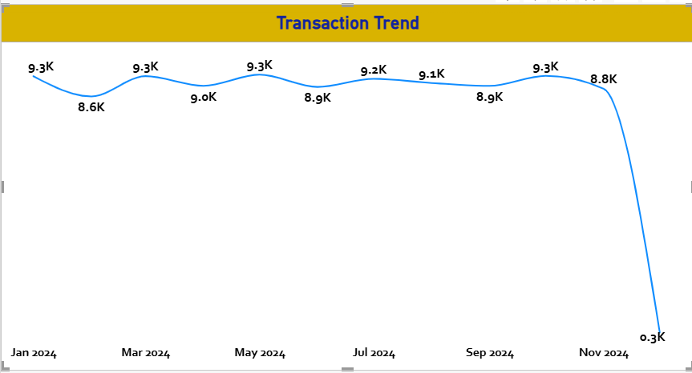
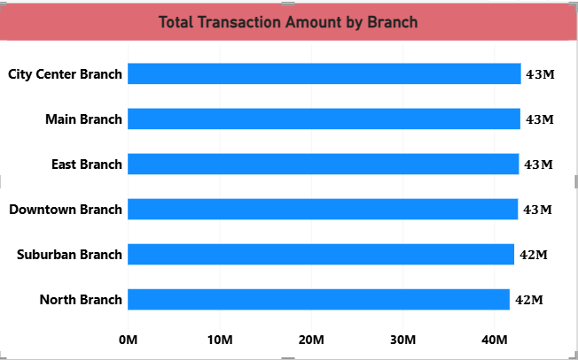
Bank Debit and Credit KPIs
6-Transactions per Day/Week/Month:
7-Total Transaction Amount by Branch
Monthly transactions stayed stable at around 9K from Jan to Oct 2024
- Sharp drop in Nov 2024 to 0.3K
Throughout the year, transactions stayed steady around 9K a month. The sudden drop in November is likely because data is incomplete for that month, which we should confirm
City Center, Main, East and Downtown: about 43M each
Suburban and North: about 42M each
Performance is very even across branches
All six branches perform almost equally, between 42 and 43 million. No single branch is dependent on or lagging far behind the others.

Slide 15

Process
End-to-end workflow followed for the banking data analysis project
1
2
3
4
5
Data Collection
Data Preparation
Excel & SQL Analysis
Dashboard Development
Insight Generation
Loan and debit/credit transaction datasets were gathered for analysis.
Excel and SQL were used to clean, structure and prepare the data for analysis.
Excel calculations and SQL queries were used to examine loan, transaction and customer metrics.
Excel, Tableau and Power BI were used to build KPI cards, charts, filters and dashboards.
The dashboards were reviewed to identify trends, comparisons and notable patterns.
Tools Used: Excel • SQL • Tableau • Power BI
Output: KPI-driven dashboards for loan portfolio performance and debit/credit transaction activity.

Slide 16
Analysis – Loan Portfolio
Key observations from the Loan Dashboard
Portfolio & Risk
Distribution & Trends
• Default loan rate: 1.56%, indicating a small share of loans marked as default in the dashboard.
• Delinquent loan rate: 10.84%, highlighting a larger set of loans with overdue payments.
• Delinquent clients: about 7K; default loans: about 1K.
• Loan status is concentrated in Active Loan (36K) and Fully Paid (16K).
• Uttar Pradesh has the highest state-wise loan count at about 12K, followed by Punjab (10.2K) and Bihar (8.5K).
• Product XLG dominates the product distribution with 56,902 loans.
• Grade B has the highest loan count (12,020), followed by A (10,085) and C (8,098).
• 26–35 is the highest age-group value shown (261.0M), followed by 36–45 (243.3M).
• 36-month maturity is more common than 60-month maturity (46K vs 20K).
Yearly disbursement peaks at 2018 (281.21M) and then declines in 2019 and 2020.

Slide 17
Analysis – Debit & Credit Dashboard
Key observations from the Debit & Credit Dashboard
Transaction Performance
Trends & Branch Activity
• Total credit amount: 127.60M, representing the total money received into accounts.
• Total debit amount: 127.29M, representing the total money withdrawn or spent.
• Net transaction amount: 318.12K, showing a small positive difference between credit and debit.
• Credit-to-debit ratio: 1.0025, indicating that credit is slightly higher than debit.
• Monthly transaction activity stays close to 9K for most months from January to October 2024.
• November shows a sharp drop to about 0.3K transactions and should be validated for completeness.
• Branch transaction values are highly even, with branches ranging from about 42M to 43M.
• Account activity is shown at 0.019%, providing an additional view of transaction activity.
Overall, the dashboard shows balanced credit and debit flows with relatively consistent transaction activity across branches.

Slide 18
Analysis – Overall Summary
What the dashboards reveal across both banking datasets
Loan Portfolio
Debit & Credit Activity
• The portfolio contains 65,536 loans with 733M in funded amount.
• Collections (814.90M) and interest (155.29M) provide a view of repayment and interest income in the dataset.
• Delinquency (10.84%) is more prominent than default (1.56%).
• Loan activity is concentrated in XLG products, Grade B, and 36-month maturity.
• The 2018 disbursement value is the highest point in the yearly trend shown.
• Credit and debit amounts are closely balanced at 127.60M and 127.29M.
• The resulting net transaction amount is positive at 318.12K.
• The credit-to-debit ratio of 1.0025 shows credit slightly exceeds debit.
• Transaction volume stays close to 9K per month for most of Jan–Oct 2024.
• Branch transaction values are very even, ranging from about 42M to 43M.
• November shows an unusually low 0.3K transactions and should be validated.
Together, the dashboards provide a consolidated view of lending performance, repayment risk and transaction activity.

Slide 19
Recommendations and Insights
Loan Portfolio
Monitor delinquency closely
Delinquency (10.84%) is considerably higher than the default rate (1.56%).
Strengthen repayment monitoring
Focus on early identification and follow-up of overdue accounts.
Review product concentration
XLG represents the largest share of loans, so product-level risk should be monitored.
Focus on portfolio segments
Grade, age group, state and maturity analysis can support more targeted lending decisions.
Track disbursement trends
The high disbursement level in 2018 followed by a decline should be monitored for changing lending patterns.
Important observation is that delinquency is higher than the default rate. This suggests that overdue payments require closer monitoring before they develop into defaults.
XLG is the dominant product, Grade B has the highest loan count, 36-month maturity is more common, and 2018 has the highest yearly disbursement.

Slide 20
Recommendations and Insights
Debit & Credit
Maintain transaction balance
Credit and debit values are closely balanced.
Monitor transaction trends
Monthly activity remains relatively consistent from January to October 2024.
Validate November
data
The sharp drop in November transactions should be checked for data completeness or reporting issues
Monitor
branch
activity
Branch transaction values are relatively even, allowing consistent comparison across branches.
Track
account activity
Account activity can be monitored along with transaction volume to identify changes in customer usage.
Analysis specifically shows credit of 127.60M, debit of 127.29M, net transaction amount of 318.12K, a credit-to-debit ratio of 1.0025, relatively stable monthly activity through October, and an unusual November drop.

Slide 21
Conclusion
The project provided a consolidated view of loan portfolio performance and banking transaction activity.
Loan analysis highlighted portfolio volume, repayment performance, delinquency, default and lending patterns.
Debit & credit analysis showed closely balanced transaction flows and consistent branch activity.
Interactive dashboards helped convert raw banking data into clear, KPI-driven insights.
The analysis can support better monitoring, risk assessment and data-driven decision-making.
Overall analysis supports these points, including the 65,536-loan portfolio, ₹733M funded amount, 10.84% delinquency, 1.56% default rate, balanced ₹127.60M credit and ₹127.29M debit, and the 1.0025 credit-to-debit ratio.

Slide 22
Challenges & Learnings
Challenges
Learnings
• Working with two banking datasets having different structures and fields.
• Cleaning, organizing and preparing the data before analysis using Excel and SQL.
• Creating KPI calculations and keeping results consistent across Excel, Tableau and Power BI.
• Designing dashboards with clear KPI cards, charts, filters and readable labels.
• Validating unusual transaction patterns, especially the sharp November 2024 drop.
• Improved practical skills in Excel, SQL, Tableau and Power BI.
• Learned to create calculated KPIs and measures for banking analysis.
• Learned how to use charts, slicers and filters to make dashboards interactive.
• Understood the importance of checking data quality and unusual values before drawing conclusions.
• Improved the ability to convert raw data into clear business insights and presentation-ready reports.
Key takeaway: Good data preparation + correct KPI calculations + clear visualization = reliable analysis.

Slide 23
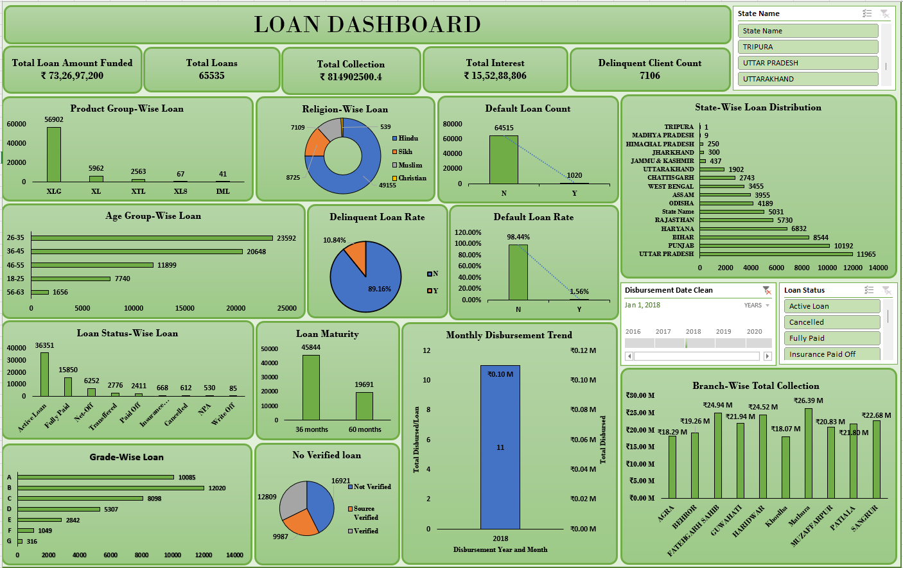
Dashboards

Slide 24
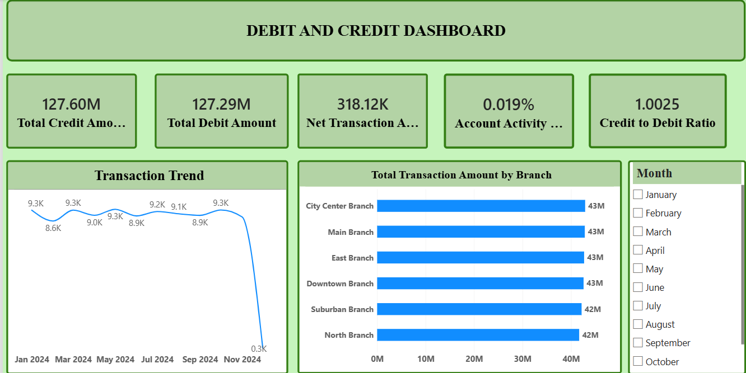
DEBIT & CREDIT DASHBOARD

Slide 25
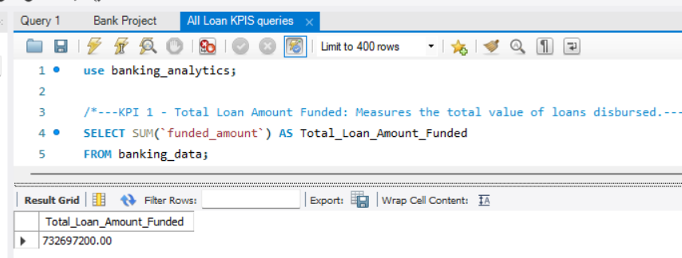
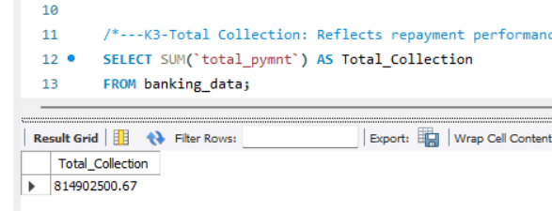
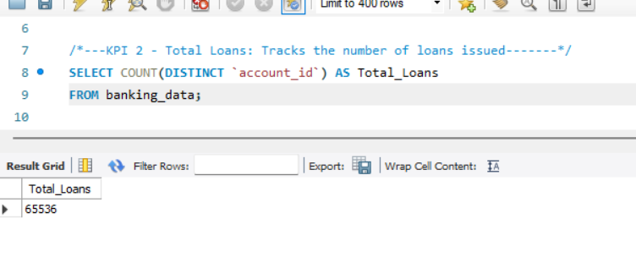
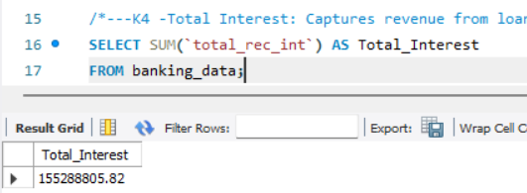
LOAN KPI
Financial Analysis
Main financial KPI
Important business/financial metric
Overall loan volume
Interest earned

Slide 26
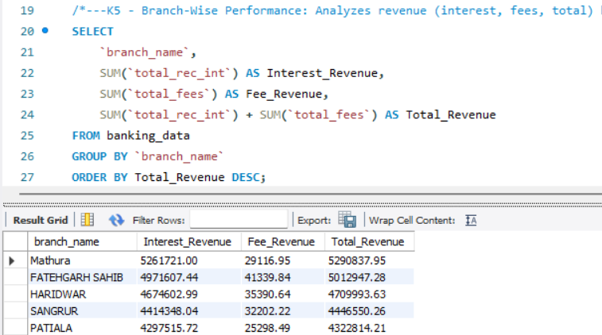
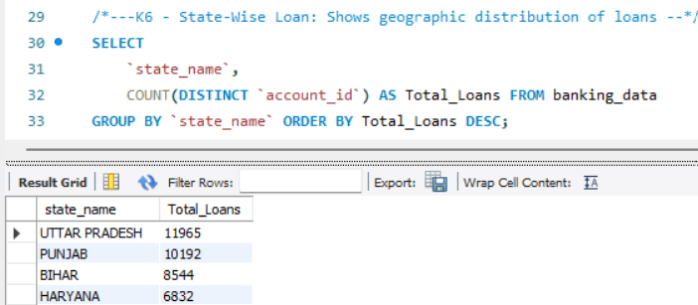
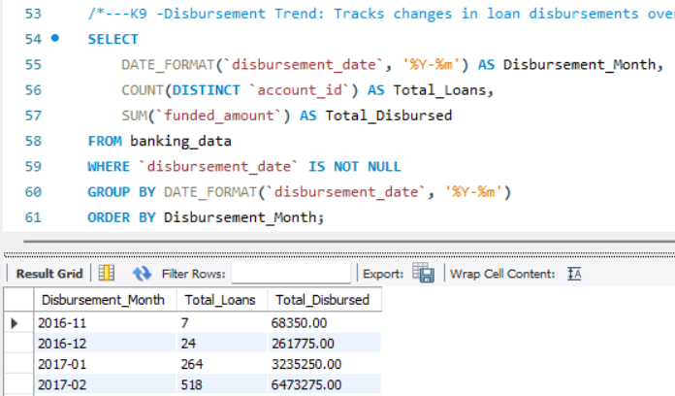
Business & Trend Analysis
Branch-Wise Performance
State-Wise Loan
Disbursement Trend

Slide 27
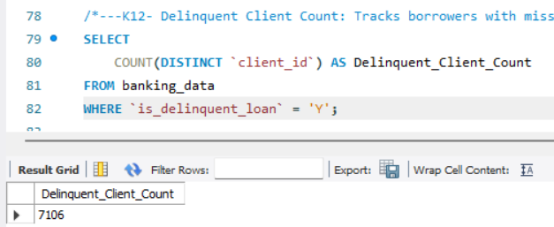
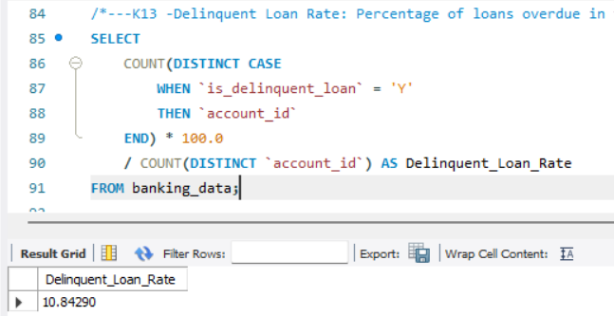
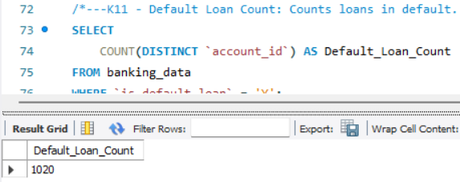
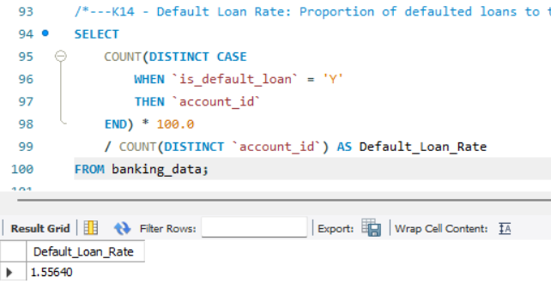
Risk Analysis
Delinquent Client Count
Delinquent Loan Rate
Default Loan Rate
Default Loan Count

Slide 28
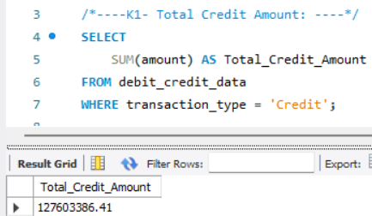
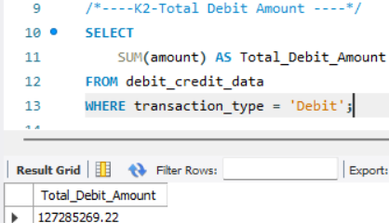
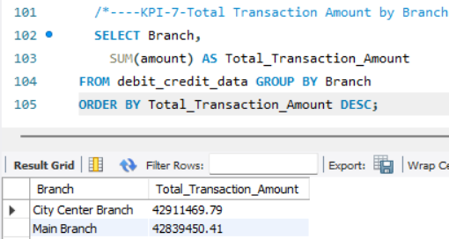
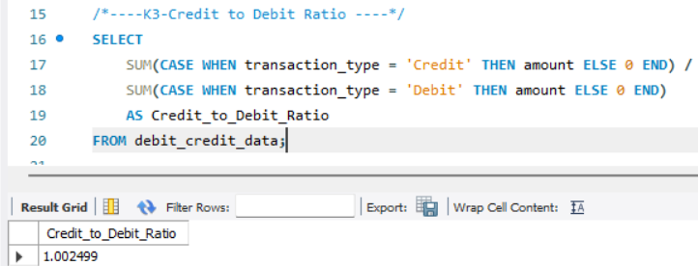
Debit And Credit KPI
Financial Summary
Branch & Bank Analysis

Slide 29
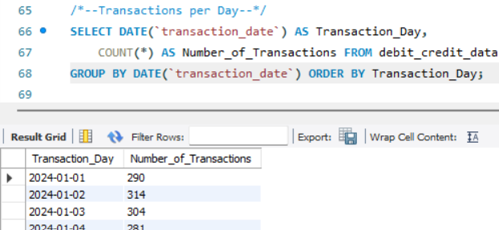
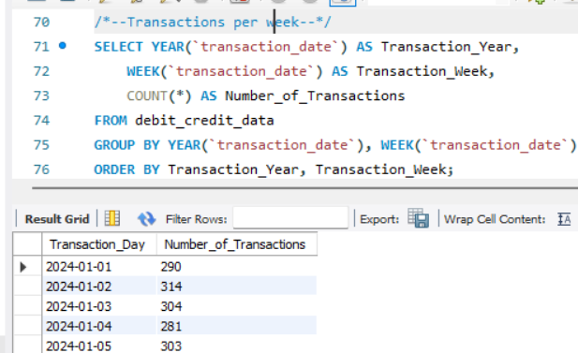
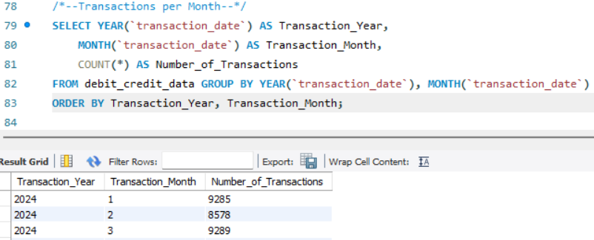
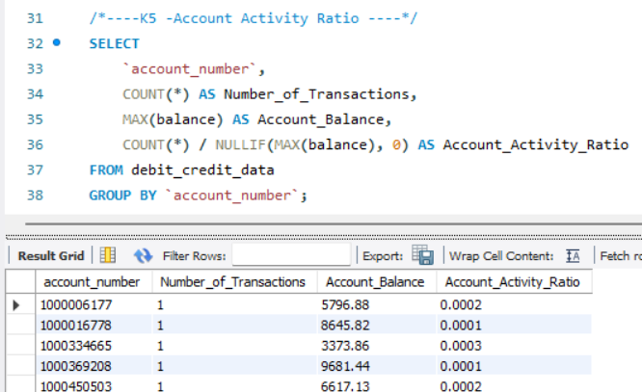
Transaction Activity
Transactions per Day/Week/Month
Account Activity Ratio

Slide 30
Thank you !
For your Time and Attention

